Slide 1

A Presentation on
Introduction of DBMS
BY :
NEHA SAHU

Slide 2
What is data?
Data is defined as facts or figures, or information that's stored in or used by a computer.
Types of Data - Mainly 3 types of data is :
Structured data
Semi - structured data
Unstructured data

Slide 3
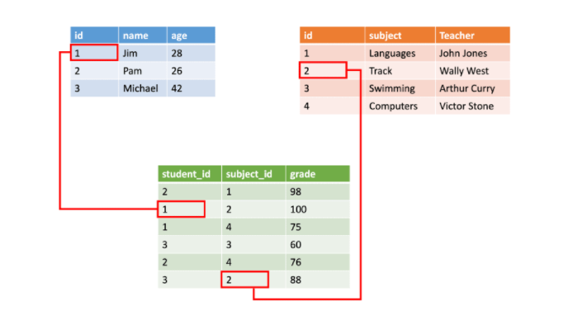
Structured data :
Structured data is generally tabular data that is represented by columns and rows in a database.
Databases that hold tables in this form are called relational databases.
SQL (Structured Query Language) programming language used for structured data.
Example: 1. IRCTC (Indian Railway catering and tourism corporation)
2. University data.

Slide 4
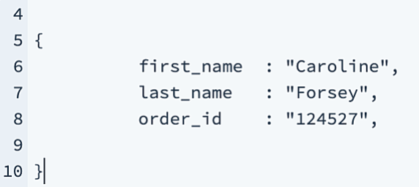
Semi - structured data :
Semi-structured data is information that doesn’t consist of Structured data (relational database) but still has some structure to it.
A good example of semi-structured data is HTML code, which doesn't restrict the amount of information you want to collect in a document, but still enforces hierarchy via semantic elements.
Another Eg. Email

Slide 5
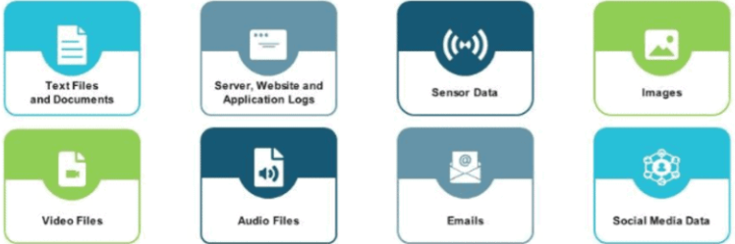
Unstructured data :
Unstructured data is information that either does not organize in a pre-defined manner or not have a pre-defined data model.
Unstructured information is a set of text, numbers, dates, and facts as well.
Videos, audio, and binary data files might not have a specific structure.

Slide 6
Introduction to DBMS :
In DBMS we mainly deal with the structured data i.e. RDBMS (Relational database management system)
Database is a collection of related data.
A database is an organized collection of data, so that it can be easily accessed and managed.
You can organize data into tables, rows, columns, and index it to make it easier to find relevant information.

Slide 7
What is RDBMS ?
RDBMS stands for Relational Database Management Systems..
All modern database management systems like MySQL , SQL server, MongoDB , MariaDB , Oracle 10g Express , DB2 (Introduced by IBM).
SQL or Structured Query Language is used to operate on the data stored in a database.
SQL depends on relational algebra and tuple relational calculus.
It is called Relational Data Base Management System (RDBMS) because it is based on relational model introduced by E.F. Codd.

Slide 8
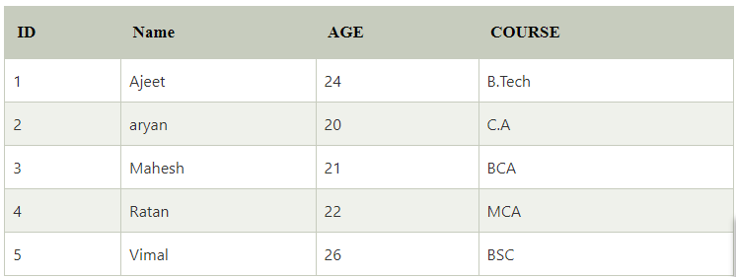
What is table?
The RDBMS database uses tables to store data. A table is a collection of related data entries and contains rows and columns to store data.
A table is the simplest example of data storage in RDBMS.

Slide 9
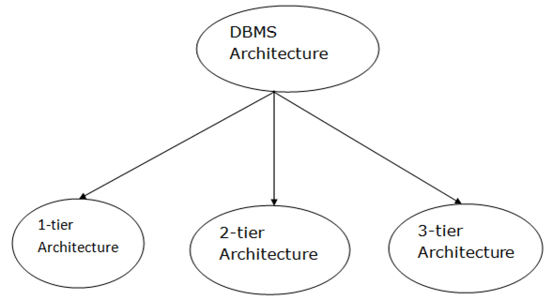
DBMS Architechture :
DBMS architecture depends upon how users are connected to the database to get their request done.
The client/server architecture consists of many PCs and a workstation which are connected via the network.
Types of DBMS Architecture :

Slide 10
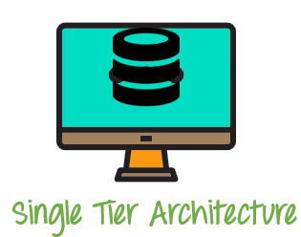
1-Tier Architecture
In this architecture the user can directly sit on the DBMS and uses it.
The 1-Tier architecture is used for development of the local application, where programmers can directly communicate with the database for the quick response.
A simple one tier architecture example would be anytime you install a database in your system and access it to practice SQL queries.

Slide 11
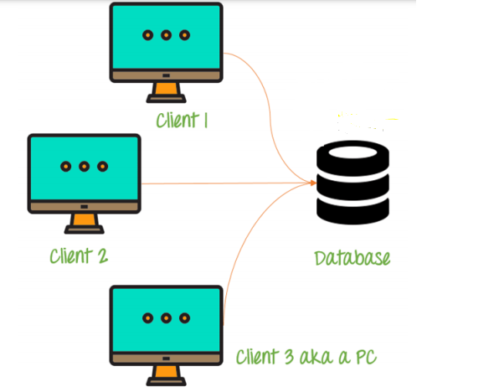
2-tier Architecture
A two-tier architecture is a database architecture where
1. Presentation layer runs on a client (PC, Mobile, Tablet, etc)
2. Data is stored on a Server.
Eg. A bank manager or cashier directly communicate with the server.
A ticket booker in railway station can directly communicate with the server

Slide 12
3-tier Architecture
3-tier schema is an extension of the 2-tier architecture.
3-tier architecture has following layers
Presentation layer (your PC, Tablet, Mobile, etc.)
Application layer / Business layer(server)
Database Server
The client does not directly communicate with the server instead it interacts with an application server which further communicates with the DBMS.

Slide 13
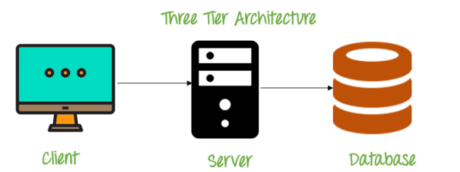
Eg. : PhonePay, GooglePay, IRCTC App where we can only interact with the business layer.
The application layer(business logic layer) also processes functional logic, constraint, and rules, all the queries before passing data to the user or down to the DBMS.
Three tier architecture is the most popular DBMS architecture

Slide 14
Advantages of 3- tier Architechture
Enhance Scalability : Due to distributed deployment of application server, now individual connection need not to be made between client and server. So number of user can not effect the performance.
Data integrity : Since there is a middle layer between client and DBMS , data corruption can be avoided / removed.
Security : this type of model prevent direct interaction of the client with the server, thereby reducing access to unauthorized data.
Disadvantage :
Maintenance is high due to complex infrastructure.

Slide 15
Thankyou!!

