Slide 1
AN INTRODUCTION TO FINANCIAL
MANAGEMENT
Shilpa lunawat Taunk
Assistant professor
(Department of Management Studies)
Vivekananda Mahavidyalaya Raipur

Slide 2
Meaning of Financial Management
Financial management refers to that part of the management activity, which is concerned with the planning, & controlling of firm’s financial resources.It is the application of the general management principles in the area of financial decision-making, namely in the areas of investment of funds, financing various activities, and disposal of profits.

Slide 3
Investment Decision
The investment decision relates to the selection of assets in which funds will be invested by a firm.Thus there are two categories of decisions:-
Capital budgeting decision.
  Long term asset investment.
Working Capital management decision.
  Current asset investment.

Slide 4
Financial Decision
Funds can be acquired through many ways and channels. Broadly speaking a correct ratio of an equity and debt has to be maintained.
This mix of equity capital and debt is known as a firm’s capital structure.
A proper balance between debt and equity is a must to ensure trade off between risk and return to the shareholders.

Slide 5
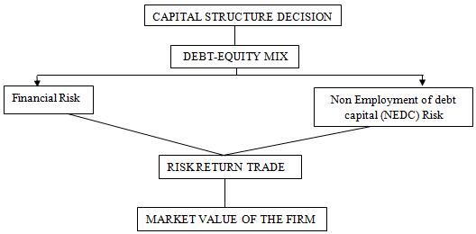

Slide 6
Dividend Decision
The key decision of a financial manager in case of profitability is to
To decide whether to distribute all the profits to the shareholder or retain all the profits or
Distribute part of the profits to the shareholder and retain the other half in the business.

Slide 7
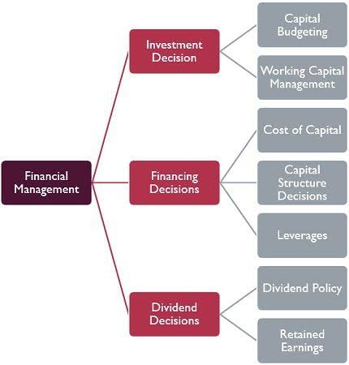

Slide 8
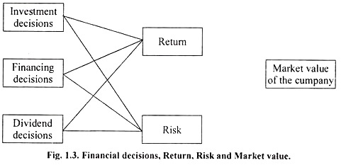
Relationship between financial decisions and Goals of the firm.

Slide 9
Objectives of the Financial Management
Profit Maximization
Wealth Maximization

Slide 10
Arguments in favour of Profit Maximization
Obvious objective
Rationality
Source of finance
Social goals
Survive under unfavorable condition

Slide 11
Arguments against profit maximization
Haziness of term “Profit”.
Ignores Time value of money.
Ignores risk.

Slide 12
Arguments against Wealth Maximization
Not socially desirable.
Objective is not descriptive.
Difficult when management and owner are separate.

Slide 13
Arguments in favour of Wealth Maximization
Universally accepted
Consistent strong dividend policy
Security to the lender

Slide 14
Thank you

